Slide 1

NCU-UAG C Collaborative Project
Group 6
COVID-19 ChatBot

Slide 2
Team Introduction
Group 6 Team members
S.No | Name | University | Country
1 | Manual Alejandro Rico Navarro | UAG | Mexico
2 | Montserrat Dueñeas Conchas | UAG | Mexico
3 | Raveesh Yadav | NCU | India
4 | Soumitra Upadhyay | NCU | India
5 | Shivam | NCU | India
6 | Tanishq Soni | NCU | India

Slide 3
Problem Statement
Objective
1. To apply conditional statements and cycles in the interaction between the user and the program.
2. Demonstrate the ability to use files for data handling.

Slide 4
Problem Statement
Instruction
Write a “COVID Chat Bot” that allows interaction between the helpline system and the user regarding queries related to COVID. The main menu will include queries in 3 categories:
1. Hospitals
2. Home care
3. Food and medicine

Slide 5
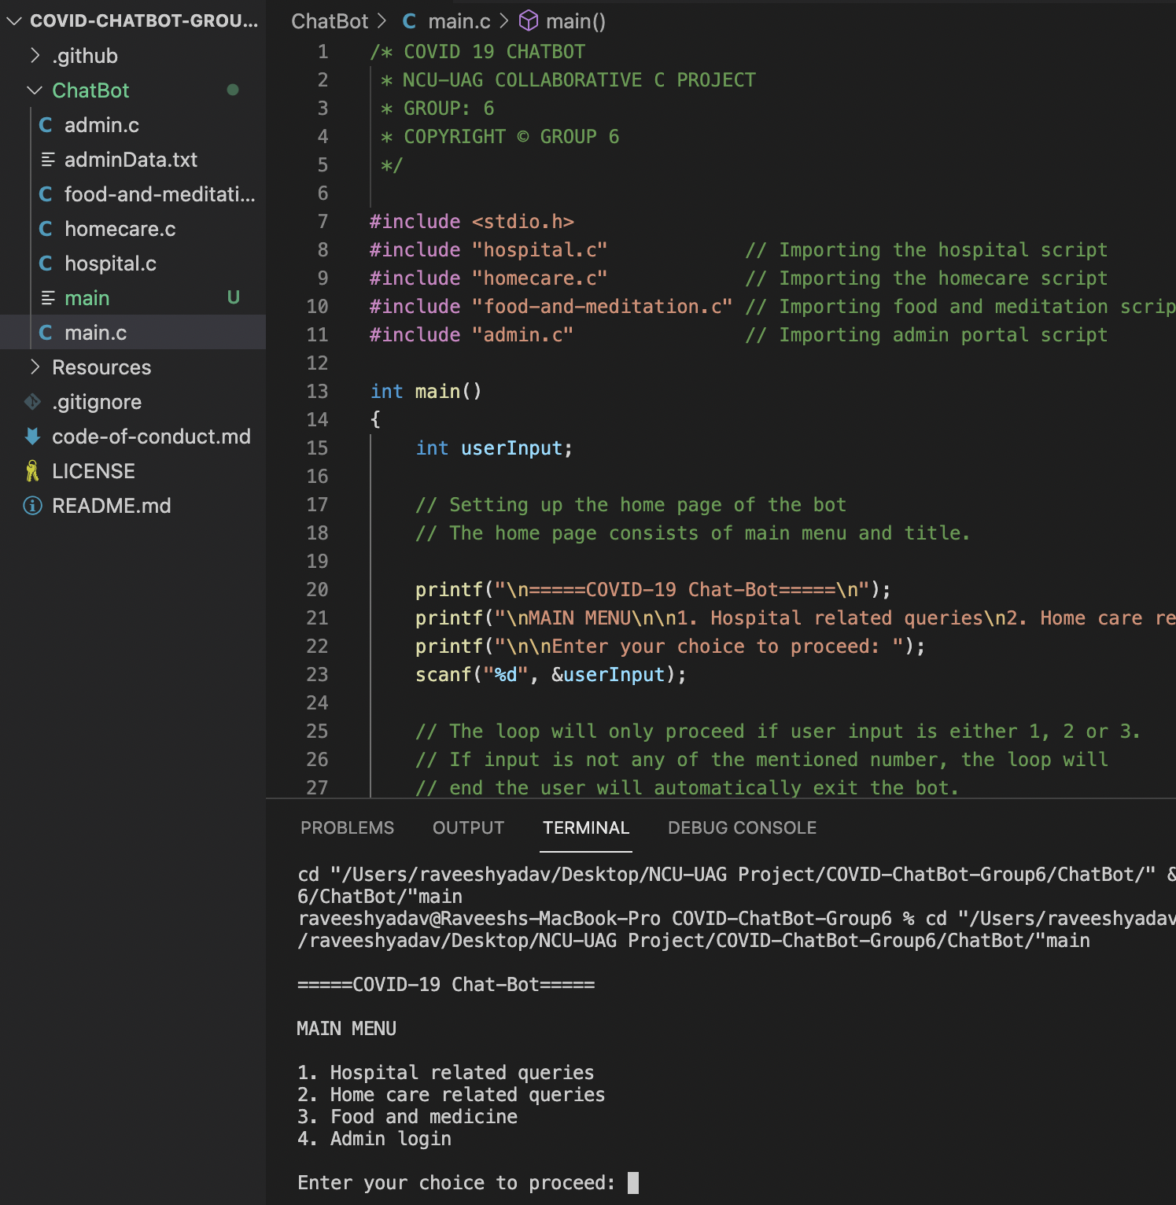
The ChatBot
Brief walkthrough
Our COVID Chat-Bot is capable of answering Hospital related, Home Care related and Medication related queries.
This Chat-Bot also provides an admin portal which is enabled using file handling. Registered admin can also add new admins.

Slide 6
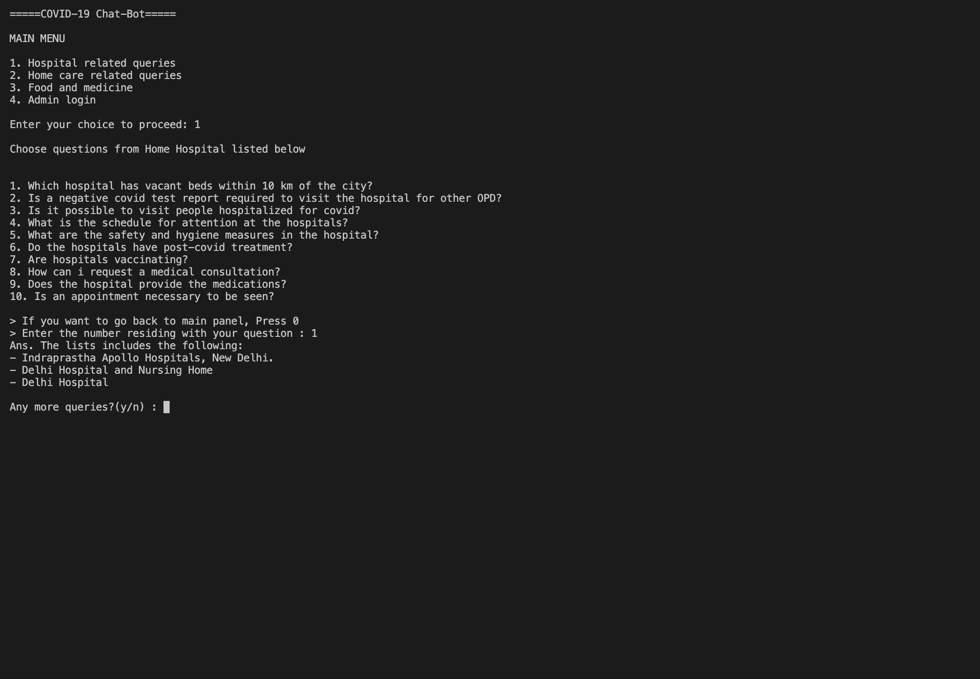
ChatBot preview
Hospital queries

Slide 7
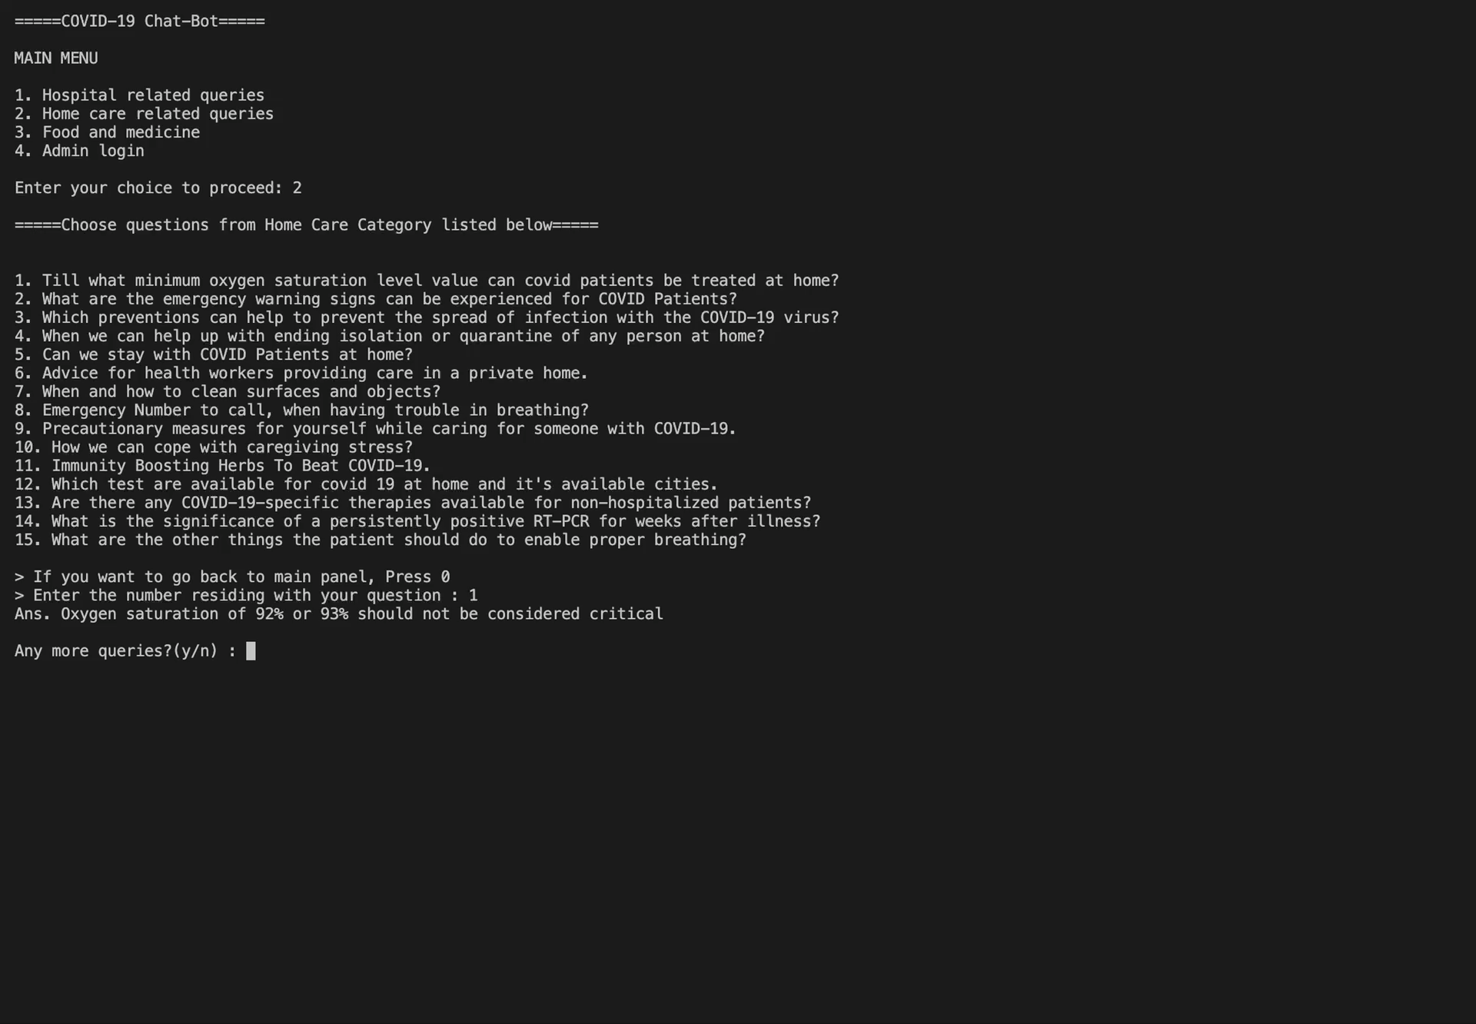
ChatBot preview
Home-care queries

Slide 8
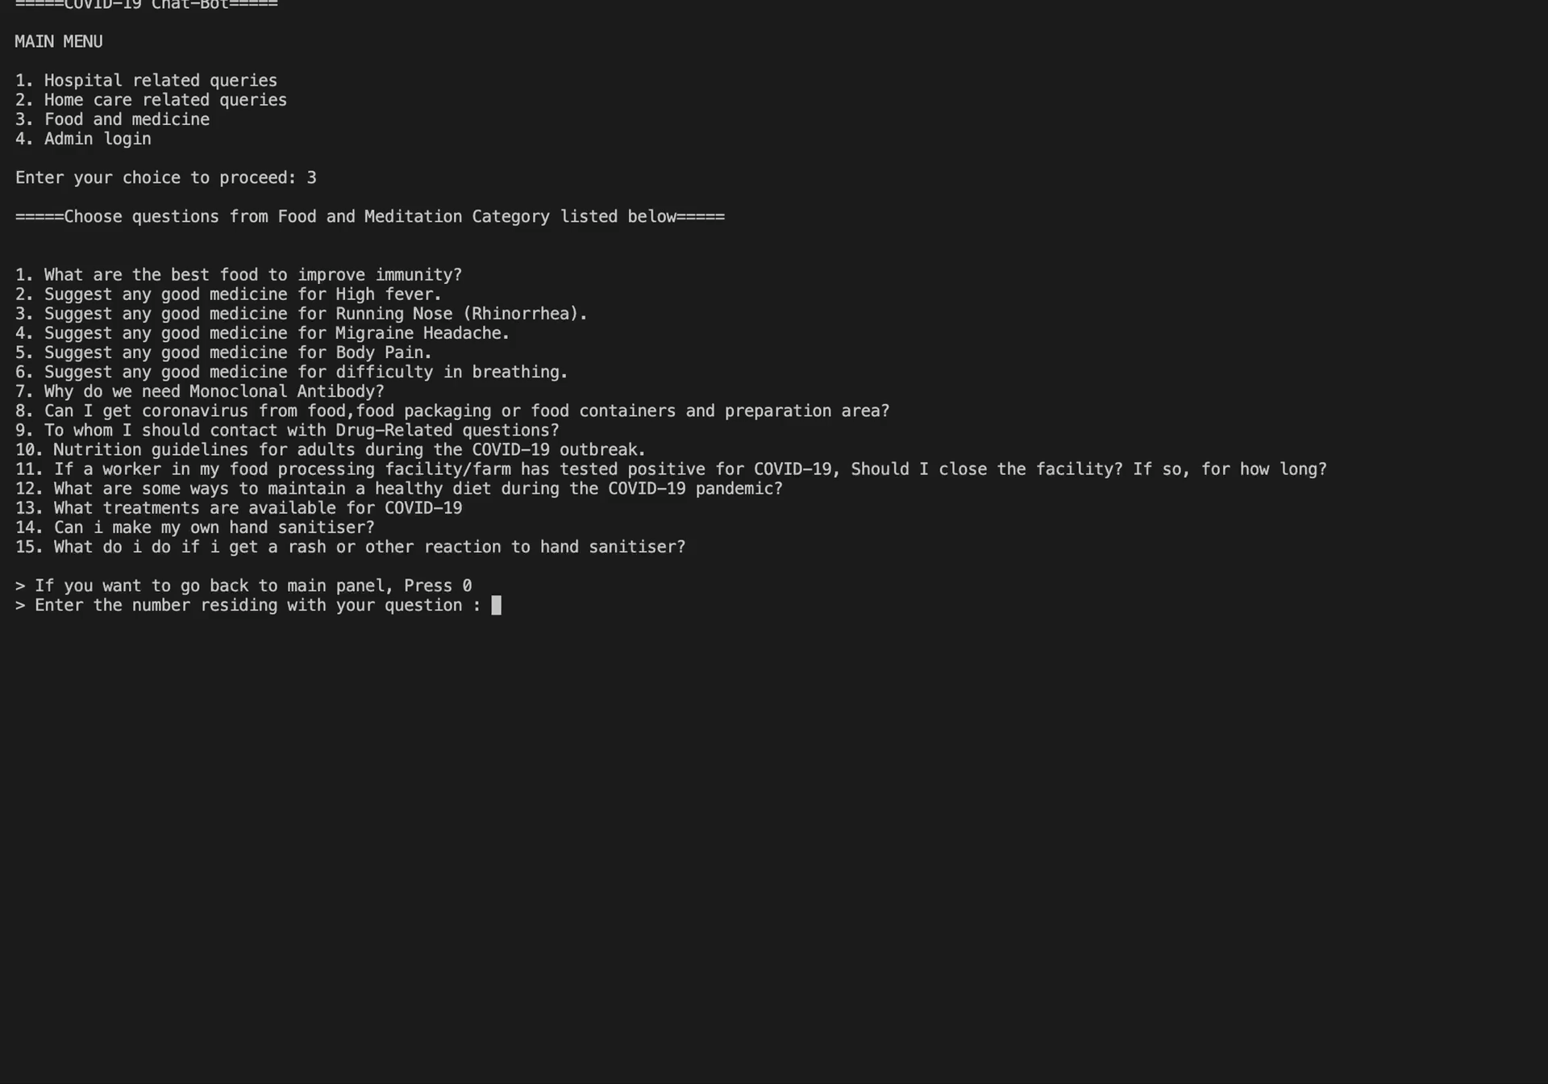
ChatBot preview
Medication queries

Slide 9
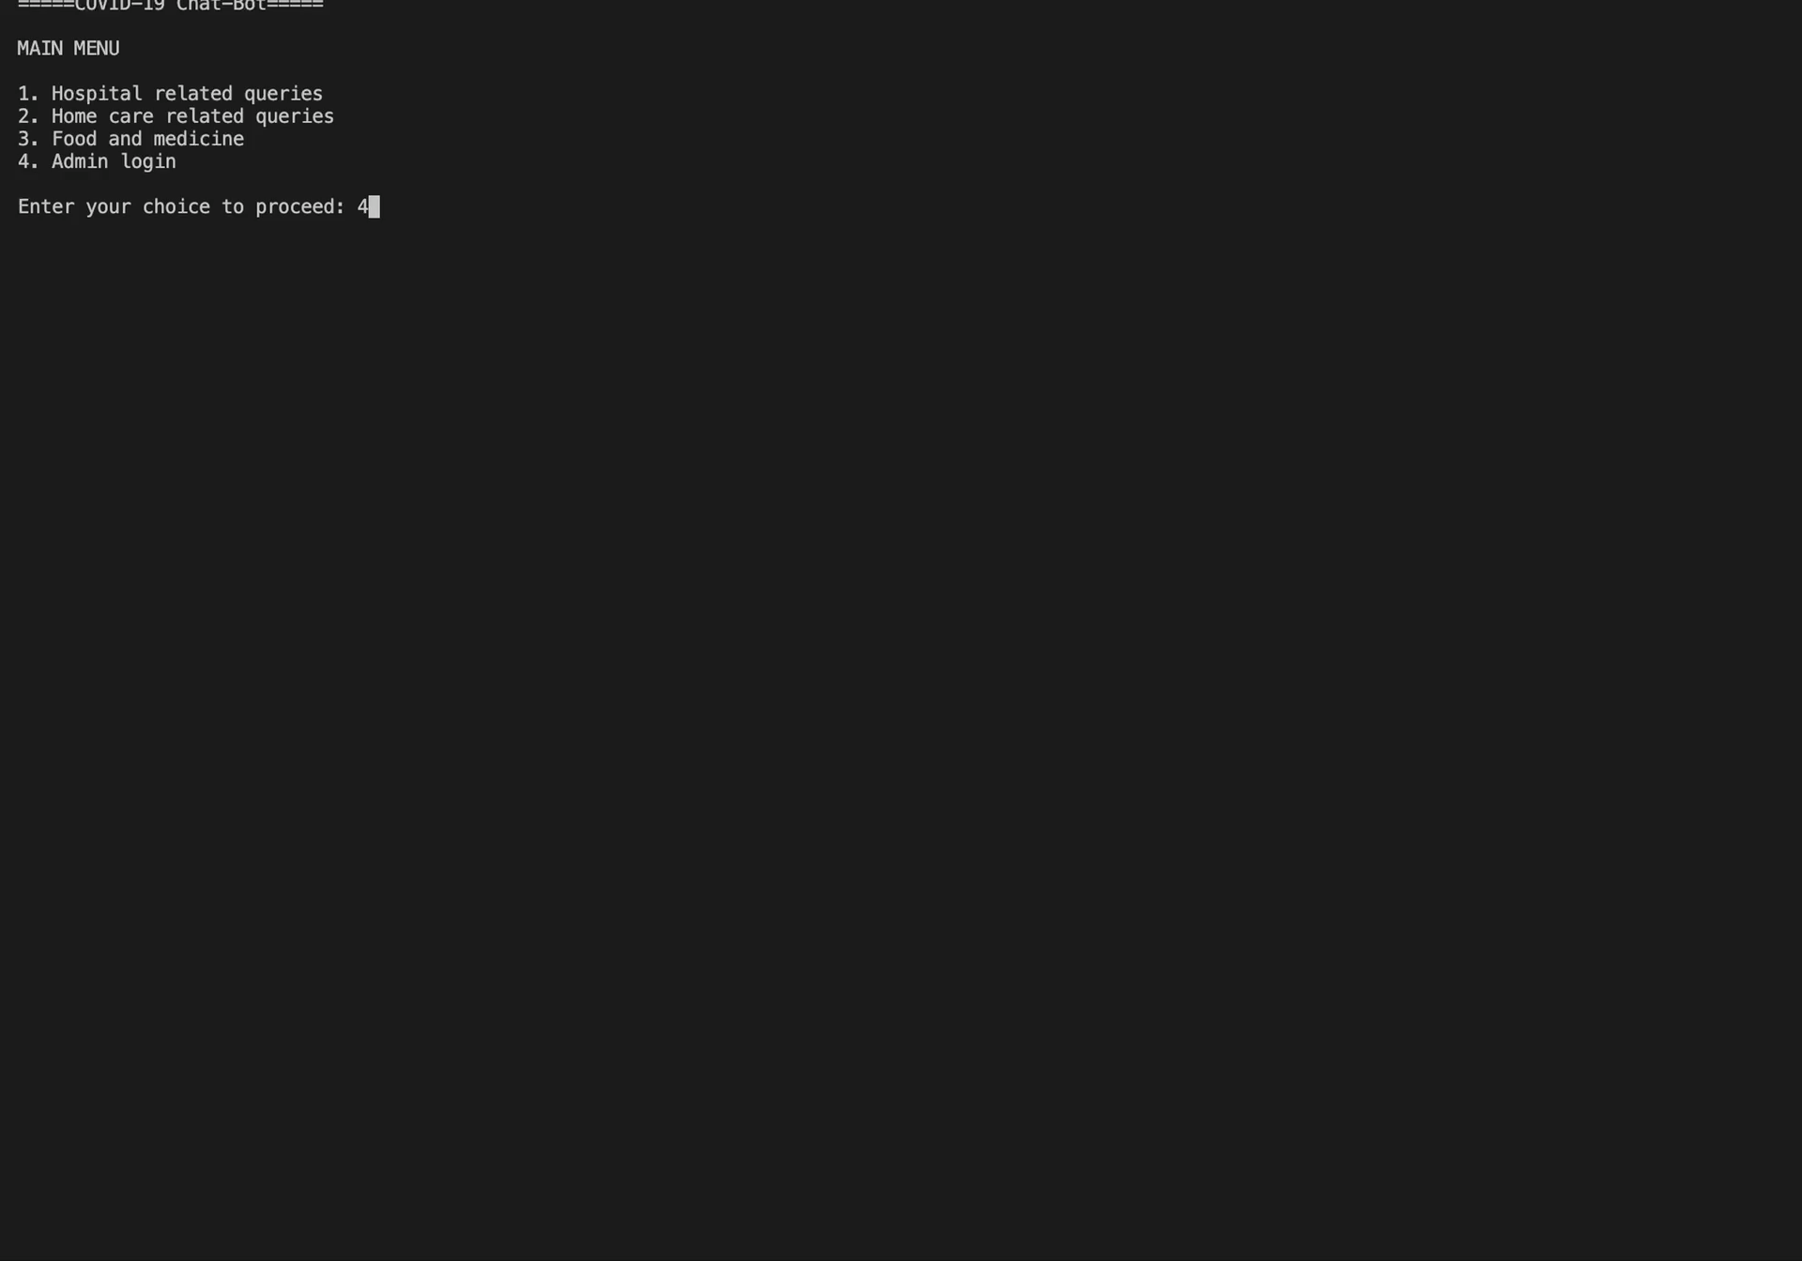
ChatBot preview
Admin Portal

Slide 10
Thank you

